Slide 1
Fresh Grads – Group Project
Forestry Management App

Slide 2
Problem Statement
The Forestry Management System will ease and facilitate the work of various organizations that depend upon natural resources from forests for their work.
Forestry management becomes important as more companies become engaged in forest related endeavours. This system can be hosted over the internet thereby enabling communication between forest plots and the different clients such as mills or other such raw material providers. The different modules of the Forestry Management System enable different functions ranging from maintenance of land records to management of inventories.
The system will store information on the land parcels owned, track historical changes in ownership and even maintain a digital database of their deeds. Modern laws require accountability for the exploitation for any natural resource in the forest and different laws and rights cover the mineral and timber resources.
The system also helps track client needs and schedule deliveries accordingly.

Slide 3
Aim of the Project:
This project will produce a fully working prototype system that provides a suitable solution to the problem. The system is intended to be a fully functioning web based database system that will allow the Forestry Manager to improve his productivity by storing and retrieving information more effectively than his current paper based system.
Scope of the Project:
The scope of the project is to create an web application for the management of the forestry goods.

Slide 4
Module Description:
Below Modules will be there in System
1.Land:This will store all the land records and the various rights assigned to all the resources in each of the land parcels. All reminders related to land related payments and other issues will be made here.
2.Client: Client accounts will be created by the Admin. Contracts will be stored under the client account and all contract related information can be accessed from the same. Clients will be able to continually update their inventory information and projected demand through this module.
3.Scheduler: The scheduler will take in information such as current inventory at the forestry business and the projected demand and inventory information at the client side. Using this information, it will be able to schedule transport and assign the right load to the right client.
Admin: The admin will be able to assign secure logins to new clients. The admin CANNOT alter record information but can add new data after authentication. The admin module can view inventory and contract settlement data and will show the contract information for verification by the forestry business.

Slide 5
Road Map
Application will be developed in following Sprints –
Core Java +JPA with Hibernate
Spring Boot + Rest Controller + JPA with Hibernate
React for UI design (Front End) + Integration with previous Sprint

Slide 6
Plan
Design
Generate the skeleton as per class design provided
TDD approach
Identify test cases for each module
Write Failing Test cases
Check the test cases
Implement the case study in incremental manner

Slide 7
Modules
Customer Module
Contract Module
Scheduler Module
Product Module
Admin Module
Order Module
Login Module
Land Module

Slide 8
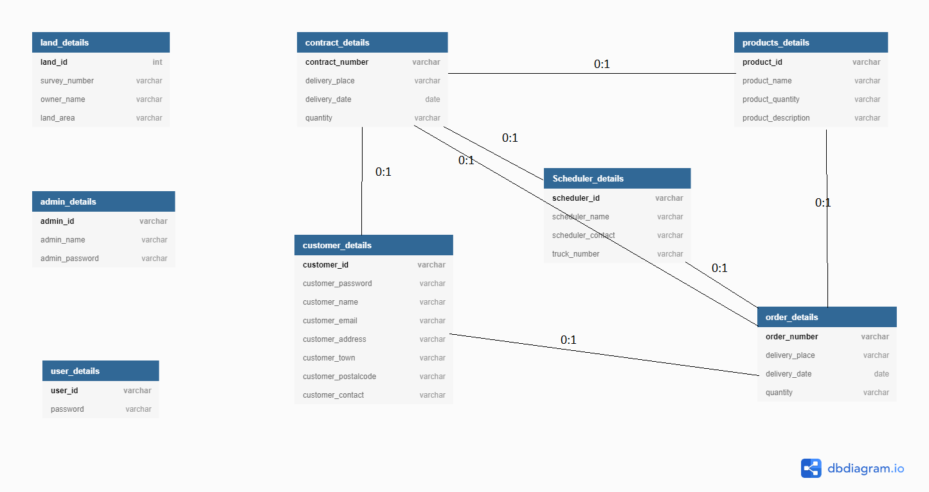

Slide 9
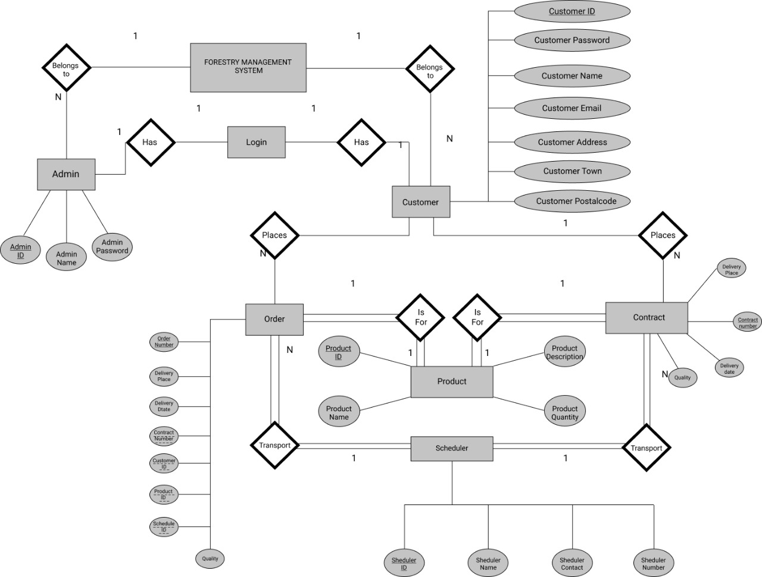

Slide 10
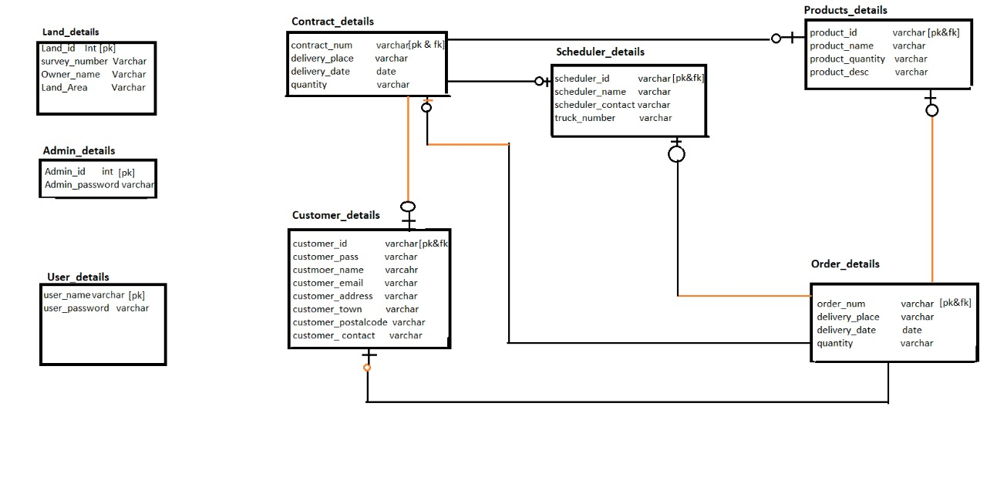

Slide 11
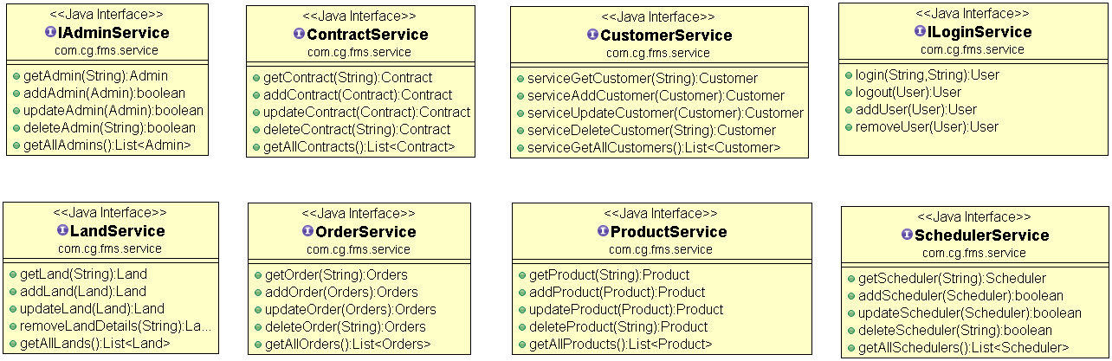
Class Design
Service Interface:

Slide 12
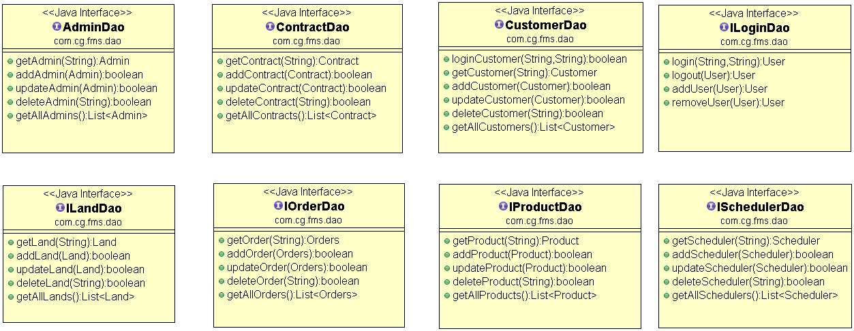
Class Design
Repository:

Slide 13
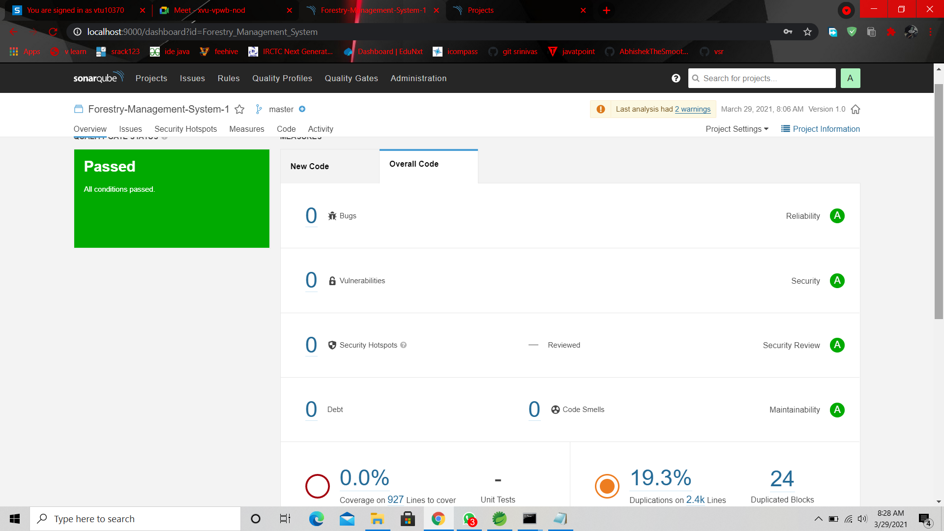

Slide 14
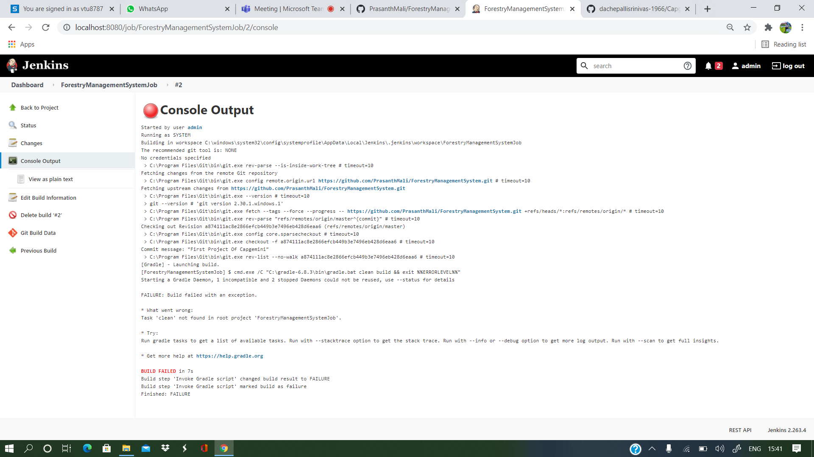

Slide 15




Questions

